Slide 1
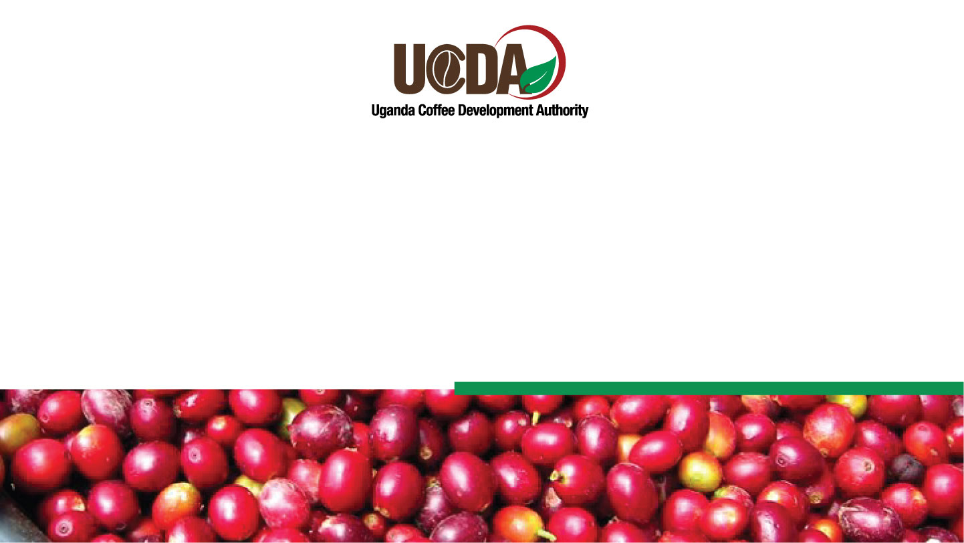

COFFEE INDUSTRY STATUS AND PROSPECTS 2026
Dr. Gerald Kyalo- Commissioner, Coffee Development

Slide 2
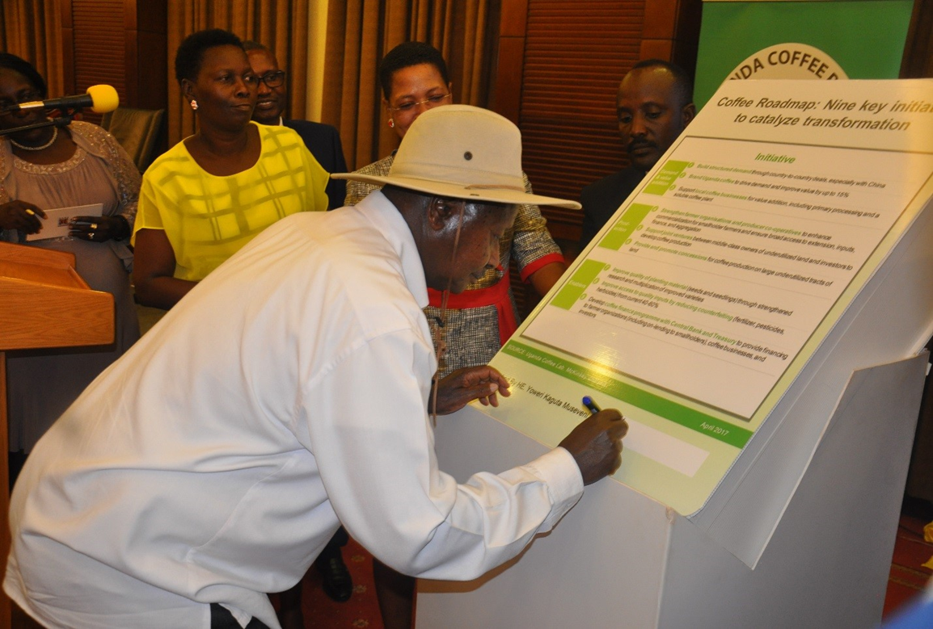
The Uganda Coffee Road map
H.E Yoweri Kaguta Museveni, The President of the Republic of Uganda signing the Coffee Roadmap, to increase Uganda coffee production to 20Million Bags by 2030

Slide 3
#1 Robusta Exporter in Africa
#2 Coffee Producer in Africa
OVERVIEW OF THE UGANDA COFFEE SUB SECTOR
# 5 Global Coffee Exporter
#4 Global Robusta Producer
9.3M
7.8M
USD 2.2B
12.5M
60kg bags
bags exported
export value
people employed
Production FY2024/25
FY2024/25
FY2024/25
across the value chain
Birthplace of Robusta
Dual-Origin Advantage
Uganda is where Robusta coffee originates. Grown across 126 of 146 districts by 2.5 million smallholder farmers who make up 80% of the farmers.
The only origin producing both premium Arabica (highland, 20%) and world-class Robusta (Lake Victoria basin, 80%) with unique profiles favourable to the Chinese market.

Slide 4
OVERVIEW OF THE UGANDA’S COFFEE SUB SECTOR
  Coffee sub sector contributes 22% of country’s foreign exchange earnings.
  Coffee is grown in nearly all regions of the country i.e grown by 126 out of 146 districts with an estimated 2.5 million farmers.
  Coffee Production is estimated at 9.3 million 60 kg-bags (FY 2024/2025)
  Coffee exports were 8.2 million 60-kg bags (CY 2024/25) valued at USD 2.2 million (UGX 8 Trillion).
  Coffee Sub sector employs over 12.5 million people.
  The majority of the coffee farmers are small scale farmers (approx. 80%)
  The EU remains the biggest market for Uganda coffee taking 68% market share .

Slide 5
Coffee Production Trend (2015/2016 to 2025/26)
Uganda Coffee Roadmap 2030 Target:
20 Million bags annually, generating USD 1.5 billion in export revenue

Slide 6
Status of the Coffee Planting Program –Inline with the Coffee Road map
Financial Year | 2018/19 | 2019/20 | 2020/21 | 2021/22 | 2022/23 | 2023/24 | 2024/25 | 2025/26
Coffee Elite | 327,555,806 | 152,329,451 | 70,416,490 | 16,294,000 | 39,427,571 | - | - | -
CWD-r Plantlets | 1,989,213 | 1,068,037 | 2,731,322 | 5,647,422 | 13,682,052 | 218,160 | - | 4,506,112
Total Seedlings | 329,545,019 | 153,397,488 | 73,147,812 | 21,941,422 | 53,109,623 | 218,160 | - | 4,506,112
The distribution of the seedlings was intended to increase production.
The scaled-down starting 2023/24 was on account of the transition to the PDM model.
However, after a special request to enhance coffee production in Northern Uganda, a special Northern Uganda coffee program was developed.

Slide 7
Status of the Coffee Planting Program in Northern Uganda
  Coffee seedling distribution has covered Mid northern and West Nile Regions with a current combined demand of 36,459,621 seedlings and an allocation of 21,596,164 representing an overall fulfillment of 59.2%.
REGION | DEMAND | ALLOCATED SEEDLINGS | FULFILLMENT RATE
Mid Northern | 19,487,364 | 11,246,164 | 57.7%
West Nile | 16,972,257 | 10,350,000 | 61%
Total | 36,459,621 | 21,596,164 | 59.20%

Slide 8
Coffee Exports to Türkiye FY 2020/21-2024/2025

Slide 9
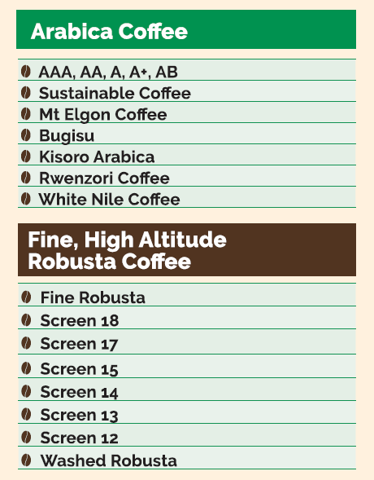
Coffee Growing Areas and Exportable Grades

Slide 10
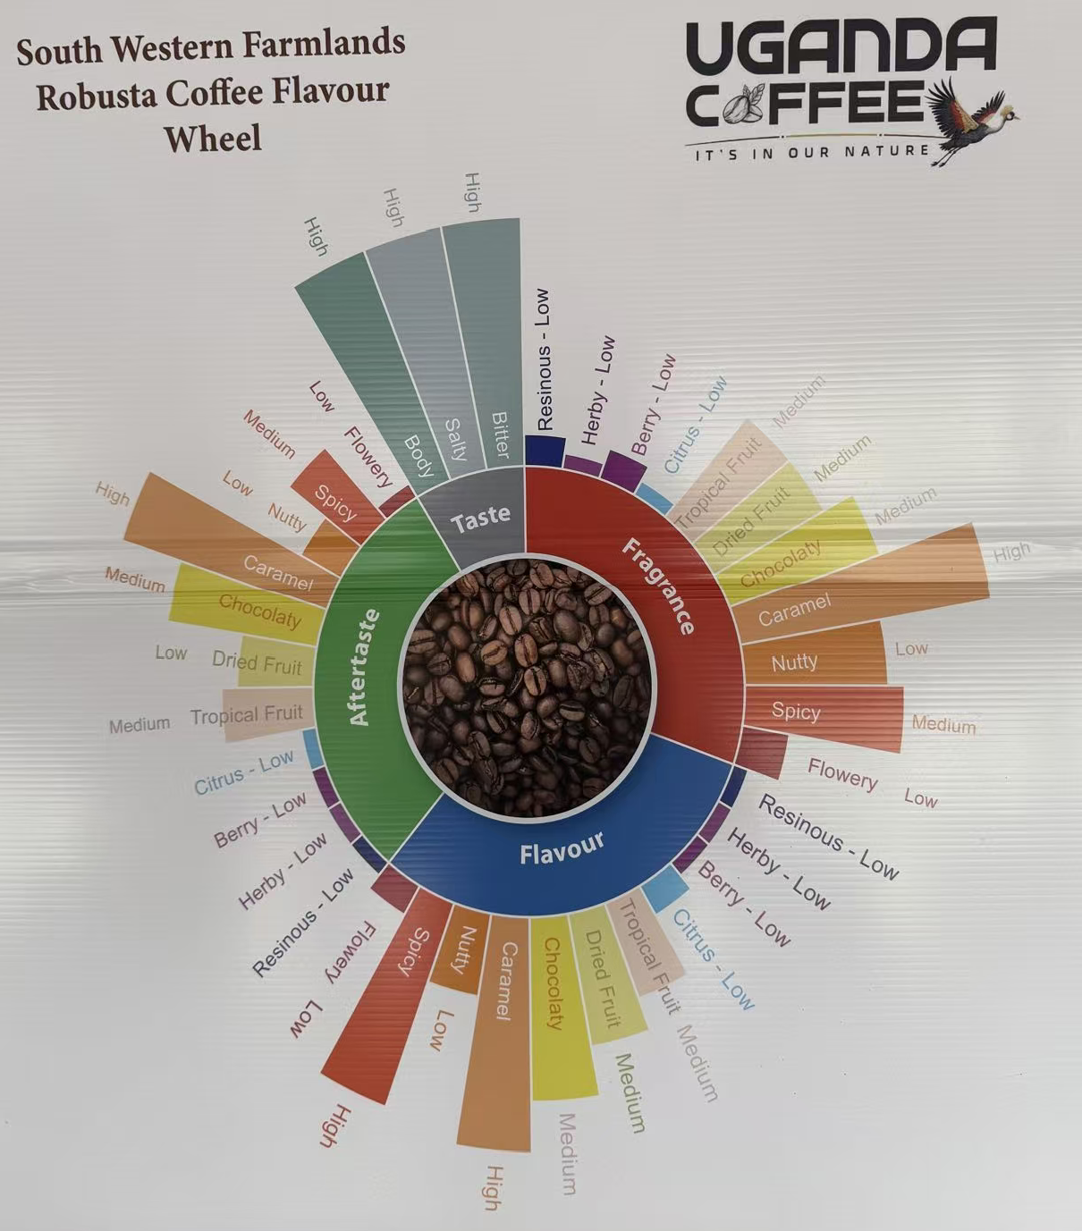
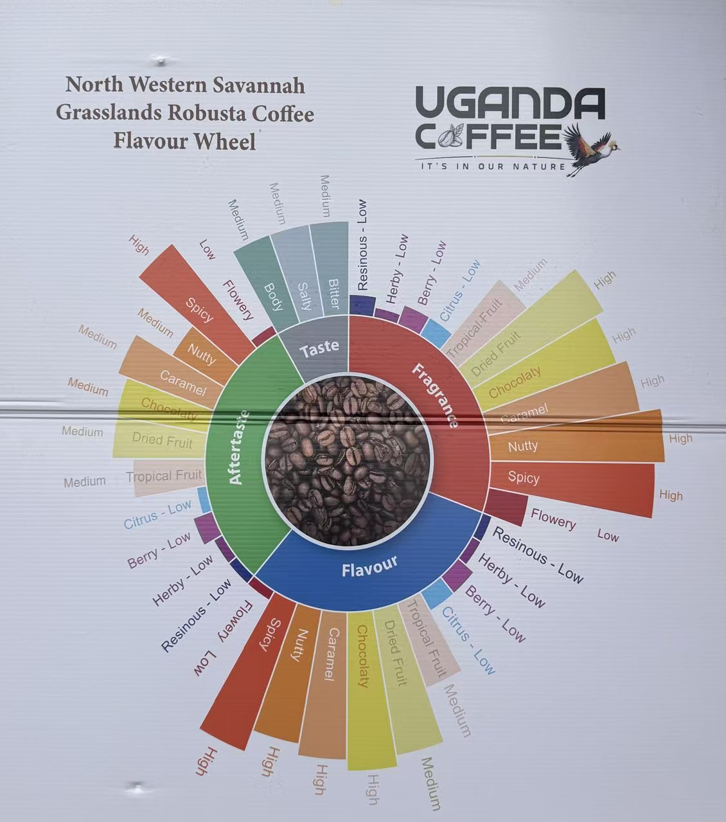
Uganda Robusta Coffee Flavour Profiles by region
South Western Farmlands
North Western Savannah Grasslands
VS
Uganda’s Robusta varies by region as evident from the South Western profiles that have a lean chocolaty & caramel with strong smooth body; North Western profiles are spicier & nuttier with higher fragrance intensity. Both are traceable to origin.

Slide 11
Coffee Export Trend (2015/2016 to 2024/25)
10
3B
8.70
$2.5B
$2.21B
3B
8
7.8
6.26
2B
6.08
6.13
6
5.61
5.12
2B
4.19
4.45
4.17
4
$1.15B
3.56
1B
2
500
$352M
0
0
2015/16
2016/17
2017/18
2018/19
2019/20
2020/21
2021/22
2022/23
2023/24
2024/25
2025*
Quantity (million bags)
Value (USD)
2025 milestone: 8.7M bags · $2.5B — record calendar year | Value +71% YoY vs +48% volume growth — both price and volume gains aligned | *2025 = Calendar year Jan–Dec
Source: MAAIF / December 2025

Slide 12
Coffee Marketing and Promotional Activities FY 2025/26
  MAAIF in collaboration with the Uganda Missions abroad have continued to promote Uganda coffee as a strategic commodity at key strategic trade expos and exhibitions.
  We promoted our coffee at SCA WOC Sandiego & Geneva, ITB Berlin, , Coffee &Tea expo in Egypt, Coeffex Istanbul, Melbourne Australia and CIIE Shanghai China among others. This created a high demand for Uganda coffee in a number key markets in Asia, Europe and Africa

Slide 13
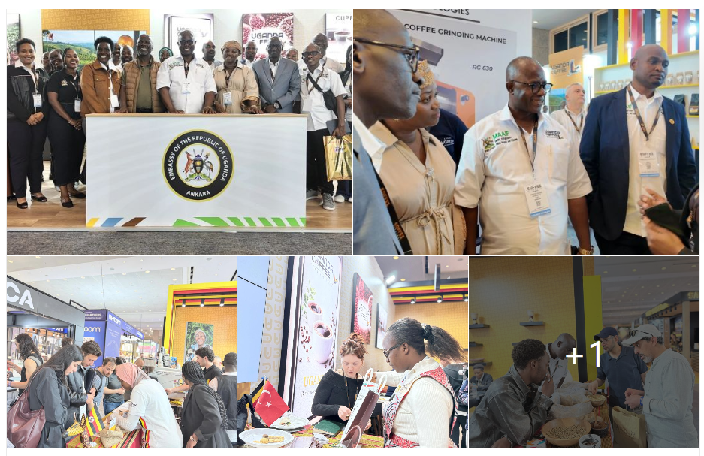
Coffee Marketing and Promotional Activities FY 2025/26
  Uganda team Led by Hon .State Minsiter for Agriculture and Ambassador Nusura Tiperu at the Coffex Istanbul

Slide 14

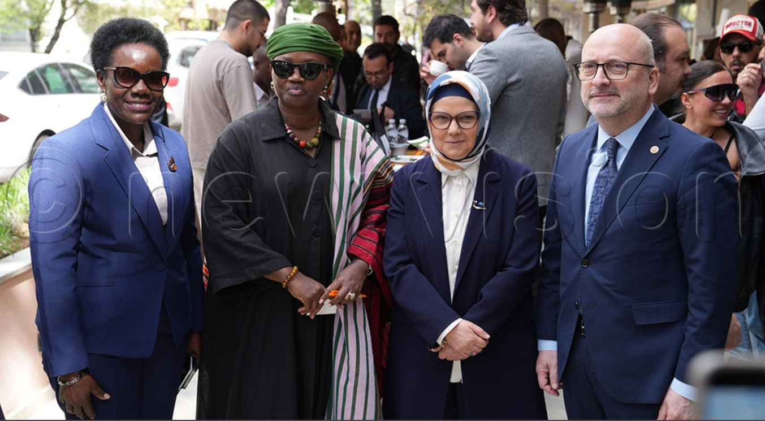

Coffee Marketing and Promotional Activities FY 2025/26
  Uganda team Led by Ambassador Nusura Tiperu at the Ankara Coffee market activation event prior to the
  Coffex Istanbul
https://www.youtube.com/watch?v=LYoVRAMJXSo

Slide 15

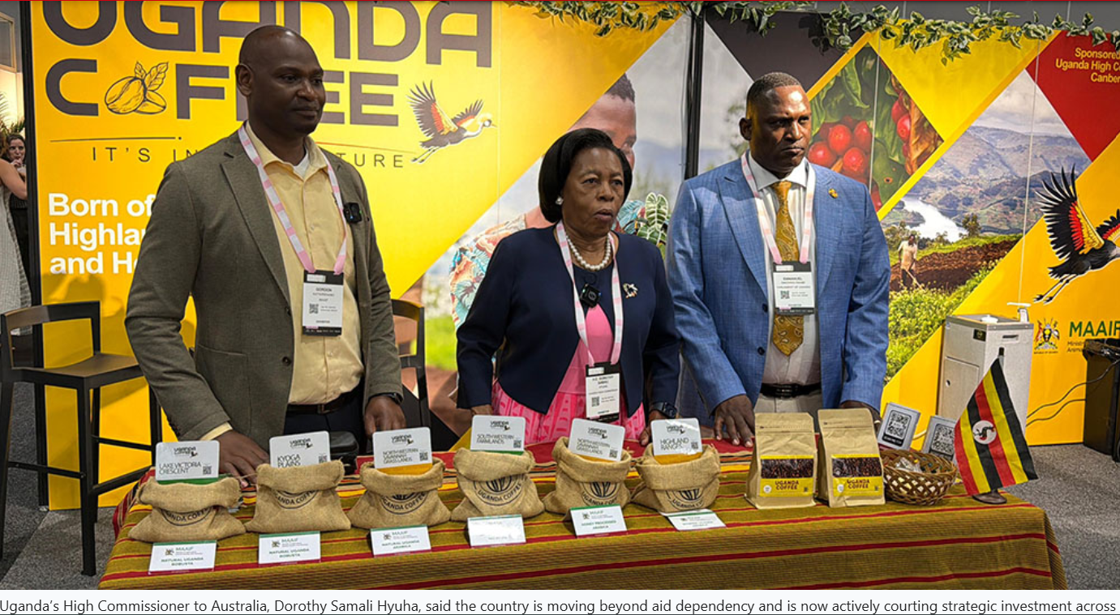
Coffee Marketing and Promotional Activities FY 2025/26

Slide 16
Investment Opportunities
01 Value Addition & Processing
02 Direct Trade
HIGH-MARGIN FDI
IMMEDIATE OPPORTUNITY
Only 7% of Uganda’s coffee exported as processed product and 93% leaves as raw beans
Invest in soluble coffee plants, roasteries, packaging facilities and benefit
Robusta for instant coffee / RTD manufacturers - price-competitive, MAAIF-graded
Unique Arabica: specialty, single-origin, traceable and fits Turkiye’s trend
03 Production
04 Luwero Coffee Industrial Park
LONG-TERM UPSIDE
STRATEGIC PLATFORM
Farm estate investment : large underutilised land available with government support
Irrigation systems for climate-resilient large-scale farming
Joint ventures with Ugandan landowners and government incentivized
Access to EAC regional market of 300M+ consumers
Cold chain and warehousing infrastructure gap presents an opportunity

Slide 17

Thank you for listening!

